Slide 1
Advance Computer Architecture
MESI Protocol

Slide 2
MESI Protocol
A practical multiprocessor invalidate protocol which attempts to minimize bus usage.
Allows usage of a ‘write back’ scheme - i.e. main memory not updated until ‘dirty’ cache line is displaced

Slide 3
MESI Protocol
Any cache line can be in one of 4 states (2 bits)
Modified - cache line has been modified, is different from main memory - is the only cached copy. (multiprocessor ‘dirty’)
Exclusive - cache line is the same as main memory and is the only cached copy
Shared - Same as main memory but copies may exist in other caches.
Invalid - Line data is not valid (as in simple cache)

Slide 4
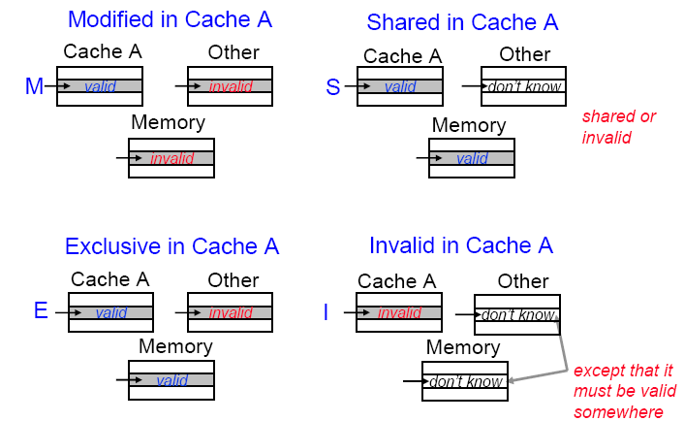
MESI Protocol

Slide 5
MESI Protocol
Cache line changes state as a function of memory access events.
Event may be either
  Due to local processor activity (i.e. cache access)
  Due to bus activity - as a result of snooping
Cache line has its own state affected only if address matches

Slide 6
MESI Protocol
Operation can be described informally by looking at action in local processor
  Read Hit
  Read Miss
  Write Hit
  Write Miss
More formally by state transition diagram

Slide 7
MESI Local Read Hit
Line must be in one of MES
This must be correct local value (if M it must have been modified locally)
Simply return value
No state change

Slide 8
MESI Local Read Miss (1)
No other copy in caches
  Processor makes bus request to memory
  Value read to local cache, marked E
One cache has E copy
  Processor makes bus request.
  Snooping cache puts copy value on the bus
  Memory access is abandoned
  Local processor caches value
  Both lines set to S

Slide 9
MESI Local Read Miss (2)
Several caches have S copy
  Processor makes bus request.
  One cache puts copy value on the bus (arbitrated)
  Memory access is abandoned
  Local processor caches value
  Local copy set to S
  Other copies remain S

Slide 10
MESI Local Read Miss (3)
One cache has M copy
  Processor makes bus request
  Snooping cache puts copy value on the bus
  Memory access is abandoned
  Local processor caches value
  Local copy tagged S
  Source (M) value copied back to memory
  Source value M -> S

Slide 11
MESI Local Write Hit (1)
Line must be one of MES
M
  line is exclusive and already ‘dirty’
  Update local cache value
  no state change
E
  Update local cache value
  State E -> M

Slide 12
MESI Local Write Hit (2)
S
  Processor broadcasts an invalidate on bus
  Snooping processors with S copy change S->I
  Local cache value is updated
  Local state change S->M

Slide 13
MESI Local Write Miss (1)
Detailed action depends on copies in other processors
No other copies
  Value read from memory to local cache
  Value updated
  Local copy state set to M

Slide 14
MESI Local Write Miss (2)
Other copies, either one in state E or more in state S
  Value read from one of the PE’s cache to local cache - bus transaction marked RWITM (read with intent to modify)
  Snooping processors see this and set their copy state to I
  Local copy updated & state set to M

Slide 15
MESI Local Write Miss (3)
Another copy in state M
Processor issues bus transaction marked RWITM
Snooping processor sees this
  Blocks RWITM request
  Takes control of bus
  Writes back its copy to memory
  Sets its copy state to I

Slide 16
MESI Local Write Miss (3)
Another copy in state M (continued)
Original local processor re-issues RWITM request
Is now simple no-copy case
  Value read from memory to local cache
  Local copy value updated
  Local copy state set to M

Slide 17
Putting it all together
All of this information can be described compactly using a state transition diagram
Diagram shows what happens to a cache line in a processor as a result of
  memory accesses made by that processor (read hit/miss, write hit/miss)
  memory accesses made by other processors that result in bus transactions observed by this snoopy cache (Mem read, RWITM,Invalidate)

Slide 18
MESI – locally initiated accesses
Read
Miss(sh)
Invalid
Shared
Read
Hit
Mem Read
Read
Miss(ex)
Invalidate
RWITM
Mem Read
Write
Hit
Write
Miss
Modified
Exclusive
Read
Hit
Read
Hit
Write
Hit
Write
Hit
= bus transaction

Slide 19
MESI – remotely initiated accesses
Mem Read
Invalid
Invalidate
Shared
Mem Read
RWITM
Mem Read
RWITM
Modified
Exclusive
= copy back

